Slide 1
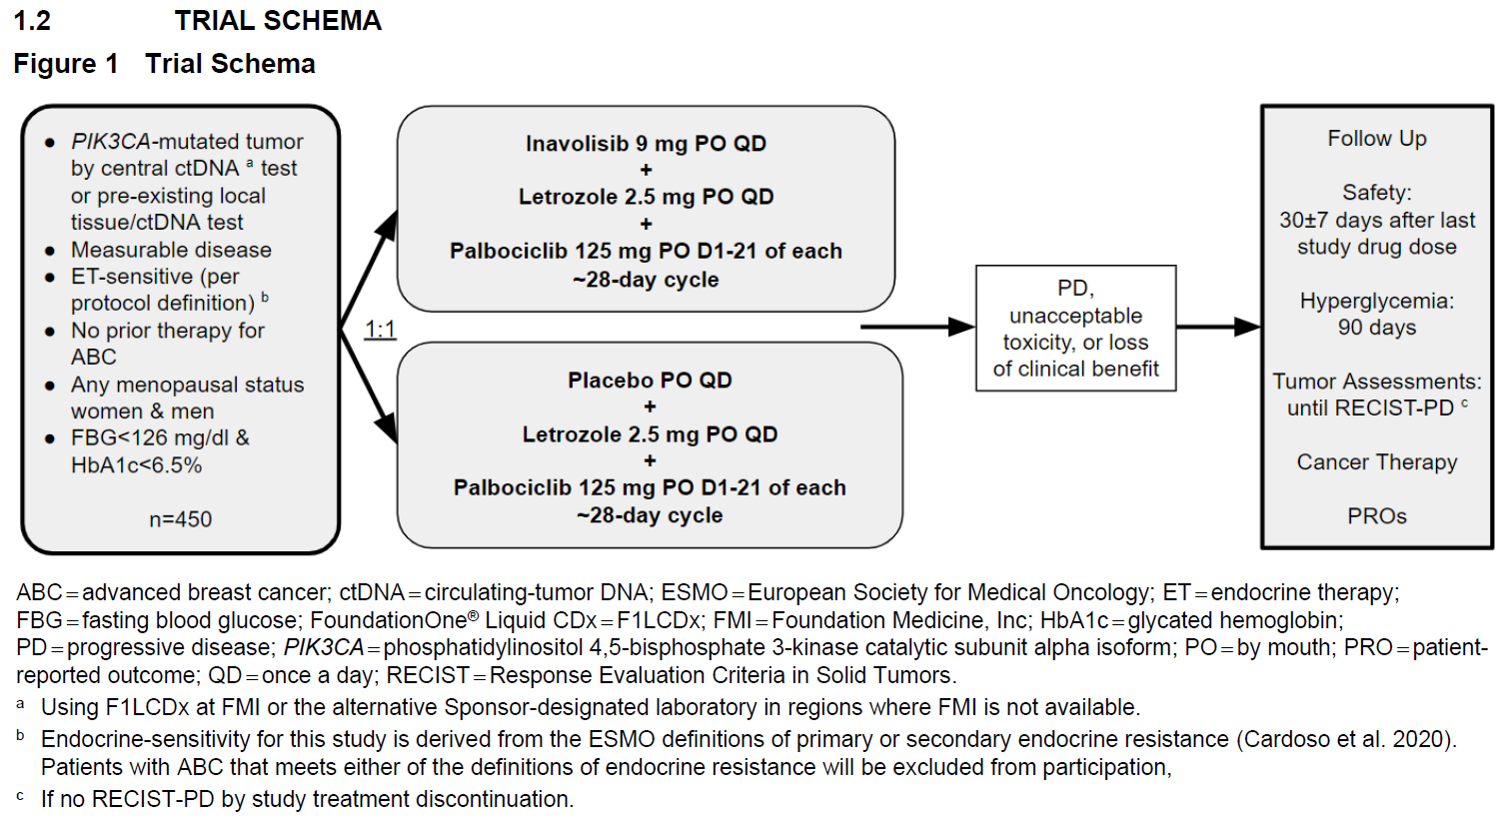
Inavolisib Ph3 RCT Endocrine-Sensitive 1L ABC NSAI as ET backbone

